Slide 1
主日信息

Slide 2
有福的人 (Blessed People) 3/12/2023 message
清心謙卑以神為中心的人
屬於主的人
跟隨主的人

Slide 3
中國信徒佈道會 (Chinese Christian Mission)
傳（Proclaim）雙月刊
2023年3月17日
呂沛淵 牧師 (Pastor Lu)
教會團契
這樣，我在你們中間，因你與我彼此的信心，就可以同得安慰。（羅1:12）

Slide 4
基督徒為甚麼要參加教會團契？有些人說：我個人跟主耶穌建立關係，在家裡上網聽聽信息，自己看看聖經，為甚麼要去教會呢？教會這麼多人，有時候彼此看不順眼甚至受傷，何必呢？所以有一些人不來教會聚會，痛苦、冷淡、退後的時候得不到別人的幫助，最後就靈命萎縮。

Slide 5
基督徒如果不參加教會聚會，作一個「獨行俠」，到時候他信或不信，連他自己都不知道，也沒有人能幫助他；「獨行俠」的危險在於，「靈命昏迷」發作的時候，沒有人能救他。另外，弟兄姊妹要彼此安慰、彼此堅固，別人可能需要你的幫助，你不來教會怎麼幫助別人呢？
～

Slide 6
神創造我們，把我們放在家庭裡面，神拯救我們，把我們放在教會團契裡面，是要我們彼此相顧。主耶穌是教會的頭，我們是祂身上的肢體，肢體要彼此相顧。所以使徒保羅說，我要在你們當中得些果子，和你們同得安慰（參羅1:12-13）。連使徒都需要教會團契，何況我們呢？
～

Slide 7
新冠疫情使人進到屬靈的沙漠
阿 摩 司 書 Amos 8:11
¹¹ 主耶和華說：日子將到，我必命饑荒降在地上。人飢餓非因無餅，乾渴非因無水，乃因不聽耶和華的話。
¹¹ “The days are coming,” declares the Sovereign Lord, “when I will send a famine through the land— not a famine of food or a thirst for water, but a famine of hearing the words of the Lord.

Slide 8
神的良善
God’s Goodness
03/26/2023

Slide 9
詩篇 Psalm 121
¹ 我要向山舉目；我的幫助從何而來？
² 我的幫助從造天地的耶和華而來。
¹ I lift up my eyes to the mountains— where does my help come from? ² My help comes from the Lord, the Maker of heaven and earth.

Slide 10
詩篇 Psalm 121
³ 他必不叫你的腳搖動；保護你的必不打盹！
⁴ 保護以色列的，也不打盹也不睡覺。
³ He will not let your foot slip— he who watches over you will not slumber; ⁴ indeed, he who watches over Israel will neither slumber nor sleep.

Slide 11
詩篇 Psalm 121
⁵ 保護你的是耶和華；耶和華在你右邊蔭庇你。
⁶ 白日，太陽必不傷你；夜間，月亮必不害你。
⁵ The Lord watches over you— the Lord is your shade at your right hand; ⁶ the sun will not harm you by day, nor the moon by night.

Slide 12
詩篇 Psalm 121
⁷ 耶和華要保護你，免受一切的災害；他要保護你的性命。
⁸ 你出你入，耶和華要保護你，從今時直到永遠。
⁷ The Lord will keep you from all harm— he will watch over your life; ⁸ the Lord will watch over your coming and going both now and forevermore.

Slide 13
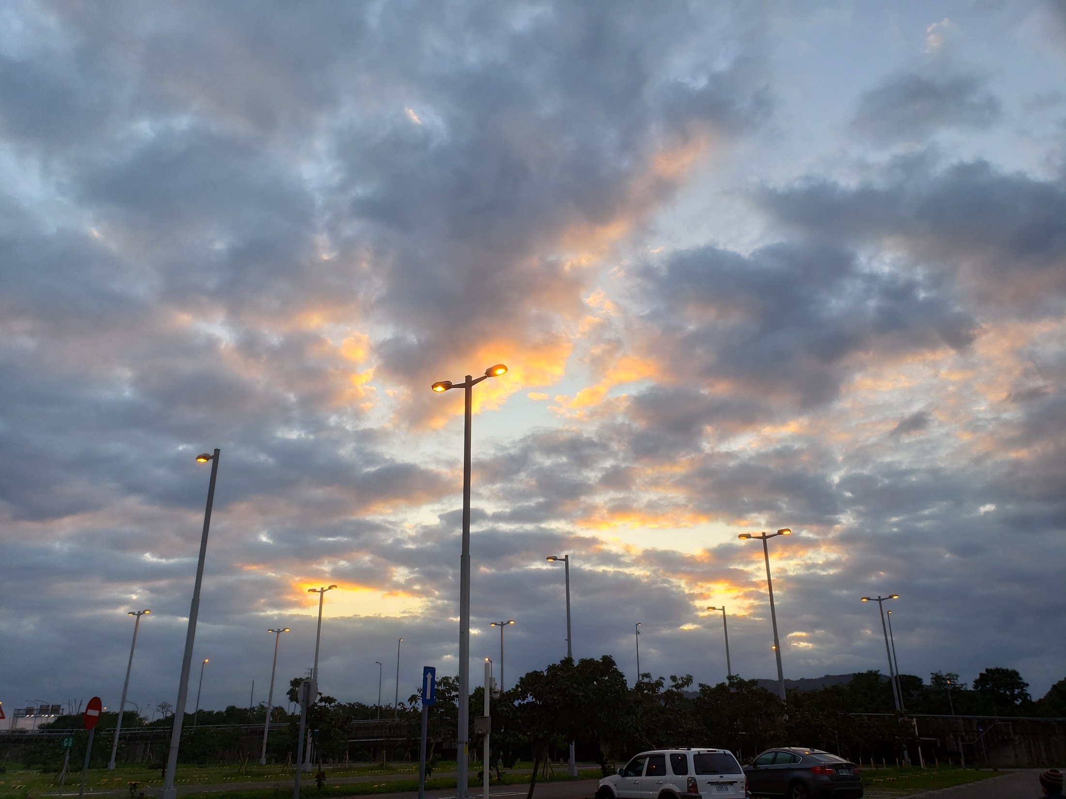

Slide 14
歷代志上 1 Chronicles 16:34
³⁴ 應當稱謝耶和華；因他本為善，他的慈愛永遠長存！
³⁴ Give thanks to the Lord, for he is good; his love endures forever.

Slide 15
羅馬書Romans 8:28
²⁸ 我們曉得萬事都互相效力，叫愛神的人得益處，就是按他旨意被召的人。
²⁸ And we know that in all things God works for the good of those who love him, who have been called according to his purpose.

Slide 16
以西結Ezekiel 30:26 (22 times)
26 我必將埃及人分散在列國，四散在列邦；他們就知道我是耶和華。
26 I will disperse the Egyptians among the nations and scatter them through the countries. Then they will know that I am the Lord.”

Slide 17
林慈信牧師（Samuel Ling）
耶穌愛我！我知道，因有聖經告訴我
Jesus loves me this I know for the Bible tells me so.

Slide 18
加爾文
《基督教要義 Institutes of the Christian Religion》
人愈認識自己，也會愈認識神。同樣，人愈認識神，就愈認識自己。
不認識自己，就不認識神
不認識神，就不認識自己
在神的榮光在中看見自己的黑暗

Slide 19
詩篇 Psalm 107:1
¹ 你們要稱謝耶和華， 因他本為善；他的慈愛永遠長存！
¹ Give thanks to the Lord, for he is good; his love endures forever.
⁶ 於是，他們在苦難中哀求耶和華；他從他們的禍患中搭救他們，
⁶ Then they cried out to the Lord in their trouble, and he delivered them from their distress.

Slide 20
詩篇 Psalm 107:1
⁶ 於是，他們在苦難中哀求耶和華；他從他們的禍患中搭救他們，
⁶ Then they cried out to the Lord in their trouble, and he delivered them from their distress.
¹³ 於是，他們在苦難中哀求耶和華；他從他們的禍患中拯救他們。
¹³ Then they cried to the Lord in their trouble, and he saved them from their distress.
¹⁹ 於是，他們在苦難中哀求耶和華；他從他們的禍患中拯救他們。
¹⁹ Then they cried to the Lord in their trouble, and he saved them from their distress.
²⁸ 於是，他們在苦難中哀求耶和華，他從他們的禍患中領出他們來。
²⁸ Then they cried out to the Lord in their trouble, and he brought them out of their distress.

Slide 21
詩篇 Psalm 107:1
⁷ 又領他們行走直路，使他們往可居住的城邑。
⁷ He led them by a straight way to a city where they could settle.

Slide 22
詩篇 Psalm 107:1
¹⁴ 他從黑暗中和死蔭裡領他們出來，折斷他們的綁索
¹⁴ He brought them out of darkness, the utter
darkness, and broke away their chains.

Slide 23
詩篇 Psalm 107:1
²⁰ 他發命醫治他們，救他們脫離死亡。
²⁰ He sent out his word and healed them; he rescued them from the grave.

Slide 24
詩篇 Psalm 107:1
²⁹ 他使狂風止息，波浪就平靜。
²⁹ He stilled the storm to a whisper; the waves of the sea were hushed.

Slide 25
帖撒羅尼迦前書 1 Thessalonians 5
¹⁶ 要常常喜樂，
¹⁷ 不住的禱告，
¹⁸ 凡事謝恩；因為這是神在基督耶穌裡向你們所定的旨意。
¹⁶ Rejoice always,
¹⁷ pray continually,
¹⁸ give thanks in all circumstances; for this is God’s will for you in Christ Jesus.

Slide 26
腓立比書Philippians 3:12-14
¹² 這不是說我已經得著了，已經完全了；我乃是竭力追求，或者可以得著基督耶穌所以得著我的（或作：所要我得的）。
¹² Not that I have already obtained all this, or have already arrived at my goal, but I press on to take hold of that for which Christ Jesus took hold of me.

Slide 27
腓立比書Philippians 3:12-14
¹³ 弟兄們，我不是以為自己已經得著了；我只有一件事，就是忘記背後，努力面前的，
¹³ Brothers and sisters, I do not consider myself yet to have taken hold of it. But one thing I do: Forgetting what is behind and straining toward what is ahead,

Slide 28
腓立比書Philippians 3:12-14
¹⁴ 向著標竿直跑，要得神在基督耶穌裡從上面召我來得的獎賞。
¹⁴ I press on toward the goal to win the prize for which God has called me heavenward in Christ Jesus.

