Slide 1
[馬太福音 Matthew 1:18-25]
18耶穌基督降生的事記在下麵：他母親馬利亞已經許配了約瑟，還沒有迎娶，馬利亞就從聖靈懷了孕。
This is how the birth of Jesus Christ came about: His mother Mary was pledged to be married to Joseph, but before they came together, she was found to be with child through the Holy Spirit.

Slide 2
19她丈夫約瑟是個義人，不願意明明地羞辱她，想要暗暗地把她休了。Because Joseph her husband was a righteous man and did not want to expose her to public disgrace, he had in mind to divorce her quietly.
20正思念這事的時候，有主的使者向他夢中顯現，說：“大衛的子孫約瑟，不要怕，只管娶過你的妻子馬利亞來，因她所懷的孕是從聖靈來的。But after he had considered this, an angel of the Lord appeared to him in a dream and said, "Joseph son of David, do not be afraid to take Mary home as your wife, because what is conceived in her is from the Holy Spirit.

Slide 3
21她將要生一個兒子，你要給他起名叫耶穌，因他要將自己的百姓從罪惡裡救出來。”
She will give birth to a son, and you are to give him the name Jesus, because he will save his people from their sins."
22這一切的事成就，是要應驗主藉先知所說的話，
All this took place to fulfill what the Lord had said through the prophet:

Slide 4
23說：“必有童女懷孕生子，人要稱他的名為以馬內利。”（“以馬內利”翻出來就是“ 神與我們同在”。）
The virgin will be with child and will give birth to a son, and they will call him Immanuel --which means, "God with us."
24約瑟醒了，起來，就遵著主使者的吩咐，把妻子娶過來，
When Joseph woke up, he did what the angel of the Lord had commanded him and took Mary home as his wife.

Slide 5
25只是沒有和她同房，等她生了兒子（有古卷作“等她生了頭胎的兒子”），就給他起名叫耶穌。
But he had no union with her until she gave birth to a son. And he gave him the name Jesus.

Slide 6
【太 Matthew 1：22-23】
22這一切的事成就，是要應驗主藉先知所說的話，
All this took place to fulfill what the Lord had said through the prophet:
23說：“必有童女懷孕生子，人要稱他的名為以馬內利。”（“以馬內利”翻出來就是“ 神與我們同在”。）
The virgin will be with child and will give birth to a son, and they will call him Immanuel --which means, "God with us."

Slide 7
【可Mark 2：17】
康健的人用不著醫生，有病的人才用得著。我來本不是召義人，乃是召罪人。
It is not the healthy who need a doctor, but the sick. I have not come to call the righteous, but sinners.”
【雅James 4：6】所以經上說：“ 神阻擋驕傲的人，賜恩給謙卑的人。”
That is why Scripture says: "God opposes the proud but gives grace to the humble."

Slide 8
【約John 3：16】
神愛世人，甚至將他的獨生子賜給他們，叫一切信他的，不至滅亡，反得永生。
For God so loved the world that he gave his one and only Son, that whoever believes in him shall not perish but have eternal life.

Slide 9
Candle Light

Slide 10
Silent Night
Silent night holy night
All is calm all is bright
Round yon virgin mother and Child
Holy Infant so tender and mild Sleep in heavenly peace Sleep in heavenly peace

Slide 11
Silent night holy night Shepherds quake at the sight Glories stream from heaven afar Heav'nly hosts sing alleluia Christ the Saviour is born Christ the Saviour is born

Slide 12
Silent night holy night Son of God love's pure light Radiant beams from the holy face With the dawn of redeeming grace Jesus Lord at Thy birth Jesus Lord at Thy birth

Slide 13
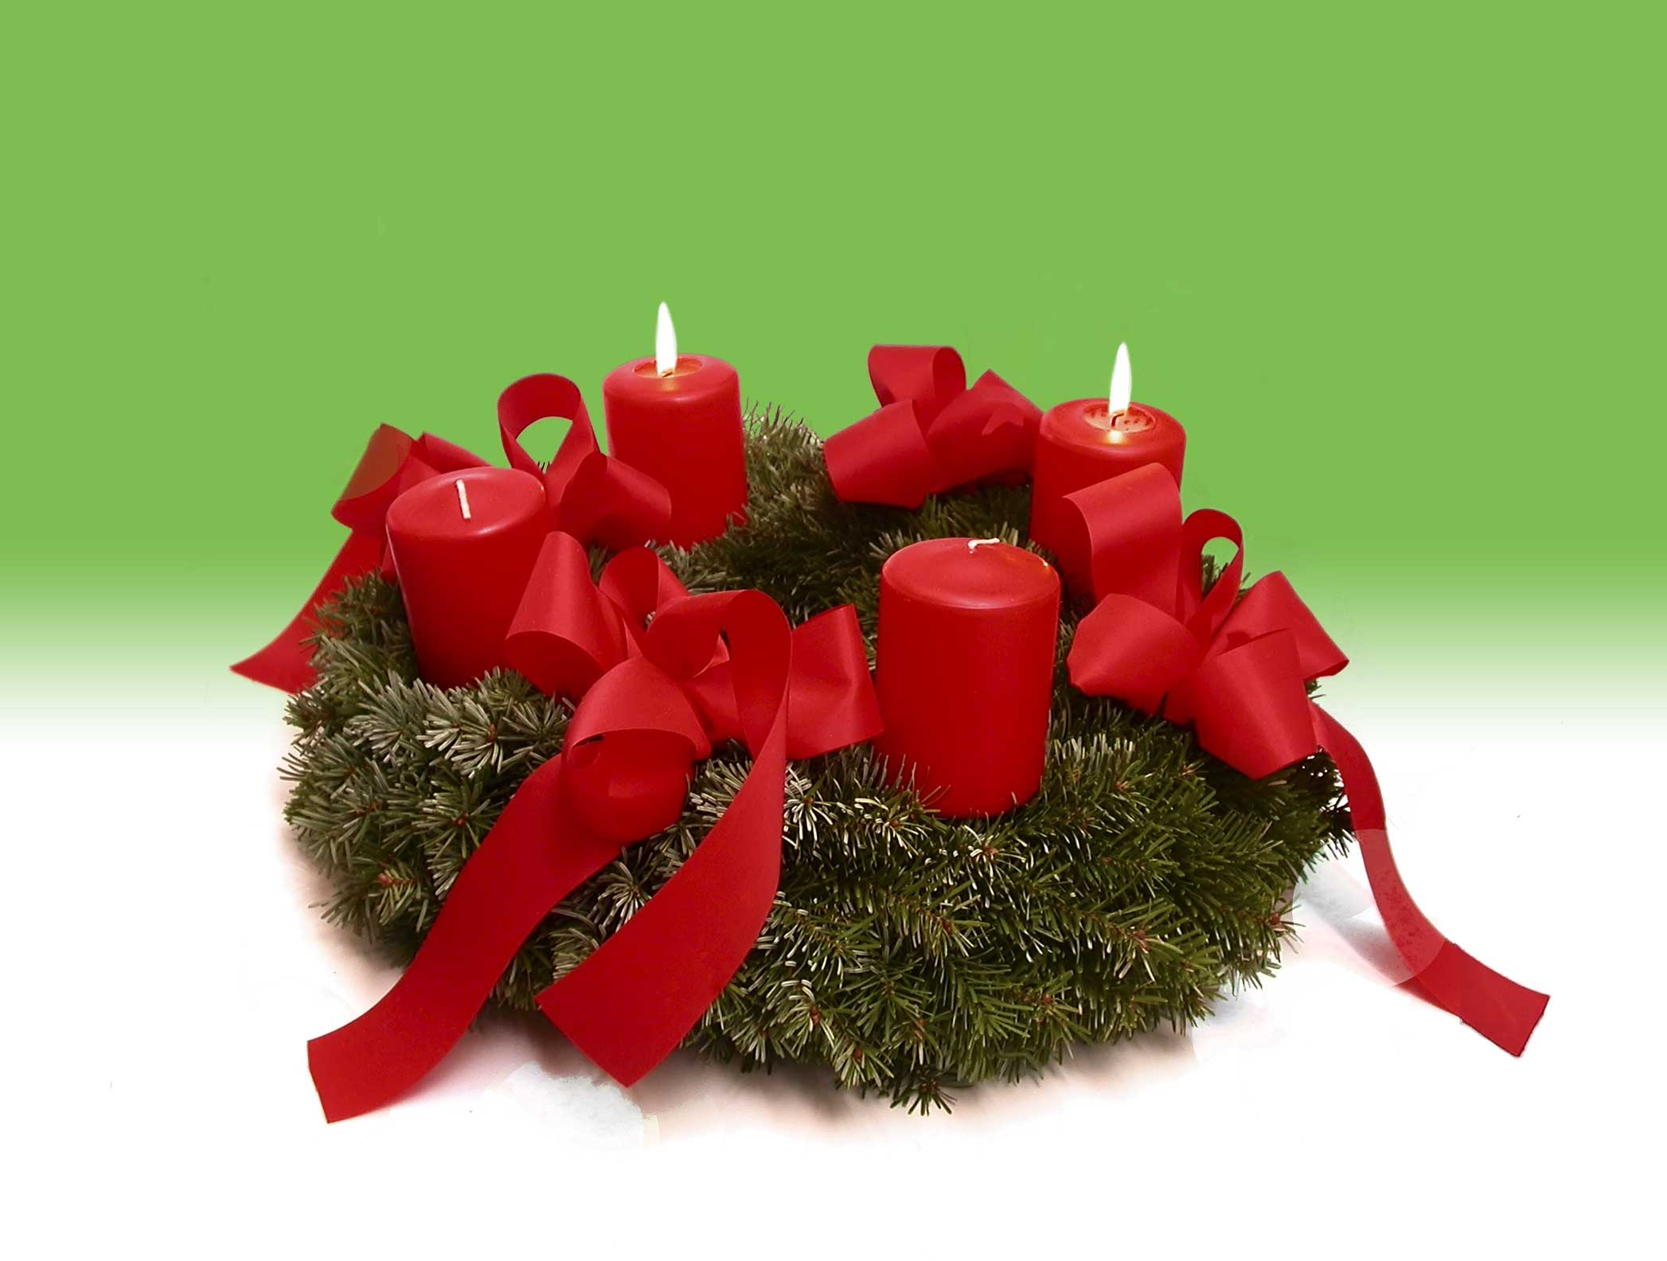
Merry Christmas!
www.centreville-umc.com

