Slide 1


Slide 2
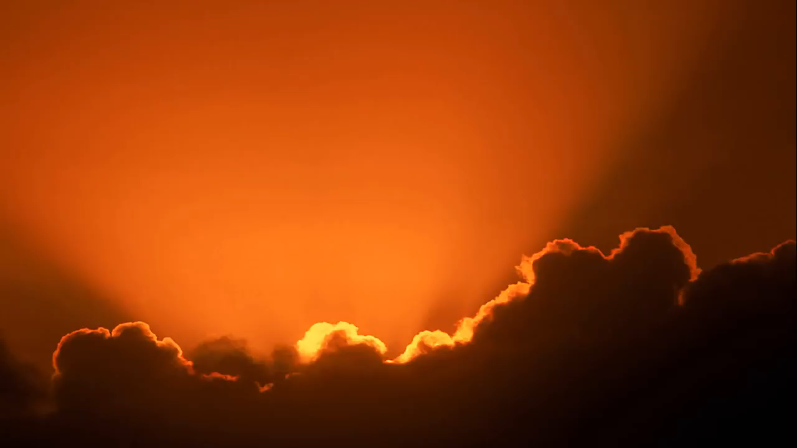

Slide 3
【申命記 Deuteronomy 5:1-21】
1 摩西將以色列衆人召了來，對他們說：“以色列人哪，我今日曉諭你們的律例、典章，你們要聽，可以學習，謹守遵行。
And Moses called all Israel, and said to them: “Hear, O Israel, the statutes and judgments which I speak in your hearing today, that you may learn them and be careful to observe them.
2 耶和華我們的 神在何烈山與我們立約。
The Lord our God made a covenant with us in Horeb.

Slide 4
【申命記 Deuteronomy 5:1-21】
3 這約不是與我們列祖立的，乃是與我們今日在這裏存活之人立的。
The Lord did not make this covenant with our fathers, but with us, those who are here today, all of us who are alive.
4 耶和華在山上，從火中，面對面與你們說話。
The Lord talked with you face to face on the mountain from the midst of the fire.

Slide 5
【申命記 Deuteronomy 5:1-21】
5 （那時我站在耶和華和你們中間，要將耶和華的話傳給你們，因爲你們懼怕那火，沒有上山。）說：
I stood between the Lord and you at that time, to declare to you the word of the Lord; for you were afraid because of the fire, and you did not go up the mountain. He said:
6 “‘我是耶和華你的 神，曾將你從埃及地爲奴之家領出來。‘
I am the Lord your God who brought you out of the land of Egypt, out of the house of bondage.

Slide 6
【申命記 Deuteronomy 5:1-21】
7 “‘除了我以外，你不可有別的神。
‘You shall have no other gods before Me.
8 “‘不可爲自己雕刻偶像，也不可作什麽形像，仿佛上天、下地和地底下水中的百物。
‘You shall not make for yourself a carved image—any likeness of anything that is in heaven above, or that is in the earth beneath, or that is in the water under the earth;

Slide 7
【申命記 Deuteronomy 5:1-21】
9 不可跪拜那些像，也不可侍奉它們，因爲我耶和華你的 神是忌邪的 神。恨我的，我必追討他的罪，自父及子，直到三四代；
you shall not bow down to them nor serve them. For I, the Lord your God, am a jealous God, visiting the iniquity of the fathers upon the children to the third and fourth generations of those who hate Me,
10 愛我、守我誡命的，我必向他們發慈愛，直到千代。but showing mercy to thousands, to those who love Me and keep My commandments.

Slide 8
【申命記 Deuteronomy 5:1-21】
11 “‘不可妄稱耶和華你 神的名；因爲妄稱耶和華名的，耶和華必不以他爲無罪。
‘You shall not take the name of the Lord your God in vain, for the Lord will not hold him guiltless who takes His name in vain.
12 “‘當照耶和華你 神所吩咐的，守安息日爲聖日。
‘Observe the Sabbath day, to keep it holy, as the Lord your God commanded you.
13 六日要勞碌作你一切的工，Six days you shall labor and do all your work,

Slide 9
【申命記 Deuteronomy 5:1-21】
14 但第七日是向耶和華你 神當守的安息日。這一日你和你的兒女、僕婢、牛、驢、牲畜，幷在你城裏寄居的客旅，無論何工都不可作，使你的僕婢可以和你一樣安息。
but the seventh day is the Sabbath of the Lord your God. In it you shall do no work: you, nor your son, nor your daughter, nor your male servant, nor your female servant, nor your ox, nor your donkey, nor any of your cattle, nor your stranger who is within your gates, that your male servant and your female servant may rest as well as you.

Slide 10
【申命記 Deuteronomy 5:1-21】
15 你也要記念你在埃及地作過奴僕，耶和華你 神用大能的手和伸出來的膀臂，將你從那裏領出來。因此，耶和華你的 神吩咐你守安息日。
And remember that you were a slave in the land of Egypt, and the Lord your God brought you out from there by a mighty hand and by an outstretched arm; therefore the Lord your God commanded you to keep the Sabbath day.

Slide 11
【申命記 Deuteronomy 5:1-21】
16 “‘當照耶和華你 神所吩咐的孝敬父母，使你得福，幷使你的日子，在耶和華你 神所賜你的地上得以長久。
‘Honor your father and your mother, as the Lord your God has commanded you, that your days may be long, and that it may be well with you in the land which the Lord your God is giving you.
17 “‘不可殺人。‘You shall not murder.
18 “‘不可奸淫。
‘You shall not commit adultery.

Slide 12
【申命記 Deuteronomy 5:1-21】
19 “‘不可偷盜。‘You shall not steal.
20 “‘不可作假見證陷害人。
‘You shall not bear false witness against your neighbor.
21 “‘不可貪戀人的妻子；也不可貪圖人的房屋、田地、僕婢、牛、驢，幷他一切所有的。’
‘You shall not covet your neighbor’s wife; and you shall not desire your neighbor’s house, his field, his male servant, his female servant, his ox, his donkey, or anything that is your neighbor’s.’

Slide 13
第九誡：不可撒謊
➢ 魔鬼是謊言的源頭
➢ 不可教唆（引導）他人撒謊
➢ 不可扭曲（加减）真相
➢ “是就說是……”
➢ 僞善的生活也是說謊

Slide 14
可以說“善意的白謊”嗎？
➢ 爲何要說謊？
➢ “白謊”反應出人性的軟弱和墮落
➢ 怎樣看妓女喇合的“白謊”？
➢ 不可將“你不可以作假見證陷害人” 引申爲 “你可以作假見證營救人”

Slide 15
怎樣從心裏遵行第九誡 “不可撒謊”？
➢ 不要對自己撒謊
➢ 不要對神撒謊
➢ 致命的謊言—假冒僞善

Slide 16
分享討論
列舉聖經中的“白謊”給人帶來的灾禍？
魔鬼對夏娃所說的話，是出于對夏娃的關心而說的“白謊”，還是出于陷害夏娃而說的“黑謊”，根據聖經討論，今天的世界流行怎樣的所謂“善意的白謊”？
分享自己因爲說真話而付出的代價？

