Slide 1
主日信息

Slide 2
没有看见就信的有福了 Blessed Are Those Who Have Not Seen and yet Believe
Boise Chinese Christian Church
4/23/2023

Slide 3
【约翰福音 John 20:24-29】
24 那十二个门徒中，有称为低土马的多马，耶稣来的时候，他没有和他们同在。
Now Thomas, called the Twin, one of the twelve, was not with them when Jesus came.
25 那些门徒就对他说：“我们已经看见主了。”多马却说：“我非看见祂手上的钉痕，用指头探入那钉痕，又用手探入祂的肋旁，我总不信。” The other disciples therefore said to him, “We have seen the Lord.”So he said to them, “Unless I see in His hands the print of the nails, and put my finger into the print of the nails, and put my hand into His side, I will not believe.”

Slide 4
【约翰福音 John 20:24-29】
26 过了八日，门徒又在屋里，多马也和他们同在。门都关了，耶稣来站在当中说：“愿你们平安！”
And after eight days His disciples were again inside, and Thomas with them. Jesus came, the doors being shut, and stood in the midst, and said, “Peace to you!”
27 就对多马说：“伸过你的指头来，摸（“摸”原文作“看”）我的手；伸出你的手来，探入我的肋旁。不要疑惑，总要信。” Then He said to Thomas, “Reach your finger here, and look at My hands; and reach your hand here, and put it into My side. Do not be unbelieving, but believing.”

Slide 5
【约翰福音 John 20:24-29】
28 多马说：“我的主，我的 神！”
And Thomas answered and said to Him, “My Lord and my God!”
29 耶稣对他说：“你因看见了我才信；那没有看见就信的有福了。”
Jesus said to him, “Thomas, because you have seen Me, you have believed. Blessed are those who have not seen and yet have believed.”

Slide 6
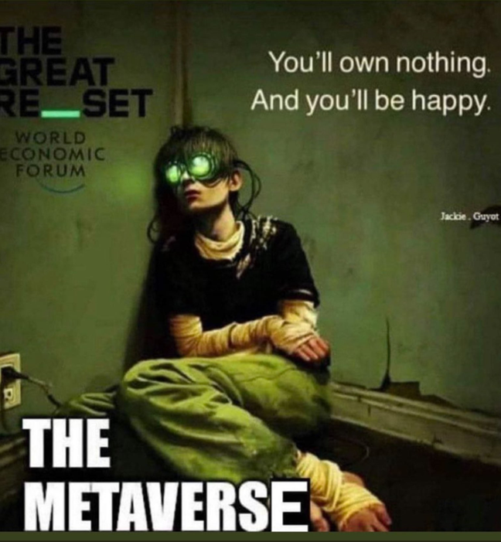

Slide 7
【马太福音 Matthew 4:8-10】
8 魔鬼又带祂上了一座最高的山，将世上的万国与万国的荣华都指给祂看，
Again, the devil took Him up on an exceedingly high mountain, and showed Him all the kingdoms of the world and their glory.
9 对祂说：“你若俯伏拜我，我就把这一切都赐给你。”
And he said to Him, “All these things I will give You if You will fall down and worship me.”

Slide 8
【马太福音 Matthew 4:8-10】
10 耶稣说：“撒但退去吧（“撒但”就是“抵挡”的意思，乃魔鬼的别名）！因为经上记着说：‘当拜主你的 神，单要侍奉祂。’”
Then Jesus said to him, “Away with you, Satan! For it is written, ‘You shall worship the Lord your God, and Him only you shall serve.’”

Slide 9
【马太福音 Matthew 18:12】
一个人若有一百只羊，一只走迷了路，你们的意思如何？他岂不撇下这九十九只，往山里去找那只迷路的羊吗？
“What do you think? If a man has a hundred sheep, and one of them goes astray, does he not leave the ninety-nine and go to the mountains to seek the one that is straying?

Slide 10
【约翰福音 John 20:24-27】
24 那十二个门徒中，有称为低土马的多马，耶稣来的时候，他没有和他们同在。
Now Thomas, called the Twin, one of the twelve, was not with them when Jesus came.
25 那些门徒就对他说：“我们已经看见主了。”多马却说：“我非看见祂手上的钉痕，用指头探入那钉痕，又用手探入祂的肋旁，我总不信。” The other disciples therefore said to him, “We have seen the Lord.” So he said to them, “Unless I see in His hands the print of the nails, and put my finger into the print of the nails, and put my hand into His side, I will not believe.”

Slide 11
【约翰福音 John 20:24-27】
26 过了八日，门徒又在屋里，多马也和他们同在。门都关了，耶稣来站在当中说：“愿你们平安！” And after eight days His disciples were again inside, and Thomas with them. Jesus came, the doors being shut, and stood in the midst, and said, “Peace to you!”
27 就对多马说：“伸过你的指头来，摸（“摸”原文作“看”）我的手；伸出你的手来，探入我的肋旁。不要疑惑，总要信。” Then He said to Thomas, “Reach your finger here, and look at My hands; and reach your hand here, and put it into My side. Do not be unbelieving, but believing.”

Slide 12
【约伯记 Job 38:1-4】
1 那时，耶和华从旋风中回答约伯说：
Then the Lord answered Job out of the whirlwind, and said:
2 “谁用无知的言语使我的旨意暗昧不明？
“Who is this who darkens counsel By words without knowledge?
3 你要如勇士束腰，我问你，你可以指示我。
Now prepare yourself like a man; I will question you, and you shall answer Me.

Slide 13
【约伯记 Job 38:1-4】
4 “我立大地根基的时候，你在哪里呢？你若有聪明，只管说吧！
“Where were you when I laid the foundations of the earth? Tell Me, if you have understanding.

Slide 14
【约翰福音 John 20:28-29】
28 多马说：“我的主，我的 神！”
And Thomas answered and said to Him, “My Lord and my God!”
29 耶稣对他说：“你因看见了我才信；那没有看见就信的有福了。”
Jesus said to him, “Thomas, because you have seen Me, you have believed. Blessed are those who have not seen and yet have believed.”

