Slide 1
主日信息

Slide 2
跑向空坟墓 Running to the Empty Tomb
Boise Chinese Christian Church
2/5/2023

Slide 3
【约翰福音 John 20:1-8】
1 七日的第一日清早，天还黑的时候，抹大拉的马利亚来到坟墓那里，看见石头从坟墓挪开了，
Now on the first day of the week Mary Magdalene went to the tomb early, while it was still dark, and saw that the stone had been taken away from the tomb.
2 就跑来见西门彼得和耶稣所爱的那个门徒，对他们说：“有人把主从坟墓里挪了去，我们不知道放在哪里。” Then she ran and came to Simon Peter, and to the other disciple, whom Jesus loved, and said to them, “They have taken away the Lord out of the tomb, and we do not know where they have laid Him.”

Slide 4
【约翰福音 John 20:1-8】
3 彼得和那门徒就出来，往坟墓那里去。
Peter therefore went out, and the other disciple, and were going to the tomb.
4 两个人同跑，那门徒比彼得跑得更快，先到了坟墓，
So they both ran together, and the other disciple outran Peter and came to the tomb first.

Slide 5
【约翰福音 John 20:1-8】
5 低头往里看，就见细麻布还放在那里，只是没有进去。
And he, stooping down and looking in, saw the linen cloths lying there; yet he did not go in.
6 西门彼得随后也到了，进坟墓里去，就看见细麻布还放在那里；
Then Simon Peter came, following him, and went into the tomb; and he saw the linen cloths lying there,

Slide 6
【约翰福音 John 20:1-8】
7 又看见耶稣的裹头巾没有和细麻布放在一处，是另在一处卷着。
and the handkerchief that had been around His head, not lying with the linen cloths, but folded together in a place by itself.
8 先到坟墓的那门徒也进去，看见就信了。
Then the other disciple, who came to the tomb first, went in also; and he saw and believed.

Slide 7
【马太福音 Matthew 21:8-11】
8 众人多半把衣服铺在路上，还有人砍下树枝来铺在路上。And a very great multitude spread their clothes on the road; others cut down branches from the trees and spread them on the road.
9 前行后随的众人喊着说：“和散那归于大卫的子孙（“和散那”原有“求救”的意思，在此乃称颂的话）！奉主名来的，是应当称颂的！高高在上和散那！” Then the multitudes who went before and those who followed cried out, saying: “Hosanna to the Son of David! ‘Blessed is He who comes in the name of the Lord!’ Hosanna in the highest!”

Slide 8
【马太福音 Matthew 21:8-11】
10 耶稣既进了耶路撒冷，合城都惊动了，说：“这是谁？” And when He had come into Jerusalem, all the city was moved, saying, “Who is this?”
11 众人说：“这是加利利拿撒勒的先知耶稣。” So the multitudes said, “This is Jesus, the prophet from Nazareth of Galilee.”

Slide 9
【路加福音 Luke 18:28-30】
28 彼得说：“看哪，我们已经撇下自己所有的跟从你了。” Then Peter said, “See, we have left all and followed You.”
29 耶稣说：“我实在告诉你们：人为 神的国撇下房屋，或是妻子、弟兄、父母、儿女，
So He said to them, “Assuredly, I say to you, there is no one who has left house or parents or brothers or wife or children, for the sake of the kingdom of God,
30 没有在今世不得百倍，在来世不得永生的。”
who shall not receive many times more in this present time, and in the age to come eternal life.”

Slide 10
【约翰福音 John 20:1-4】
1 七日的第一日清早，天还黑的时候，抹大拉的马利亚来到坟墓那里，看见石头从坟墓挪开了，
Now on the first day of the week Mary Magdalene went to the tomb early, while it was still dark, and saw that the stone had been taken away from the tomb.
2 就跑来见西门彼得和耶稣所爱的那个门徒，对他们说：“有人把主从坟墓里挪了去，我们不知道放在哪里。” Then she ran and came to Simon Peter, and to the other disciple, whom Jesus loved, and said to them, “They have taken away the Lord out of the tomb, and we do not know where they have laid Him.”

Slide 11
【约翰福音 John 20:1-4】
3 彼得和那门徒就出来，往坟墓那里去。
Peter therefore went out, and the other disciple, and were going to the tomb.
4 两个人同跑，那门徒比彼得跑得更快，先到了坟墓，
So they both ran together, and the other disciple outran Peter and came to the tomb first.

Slide 12
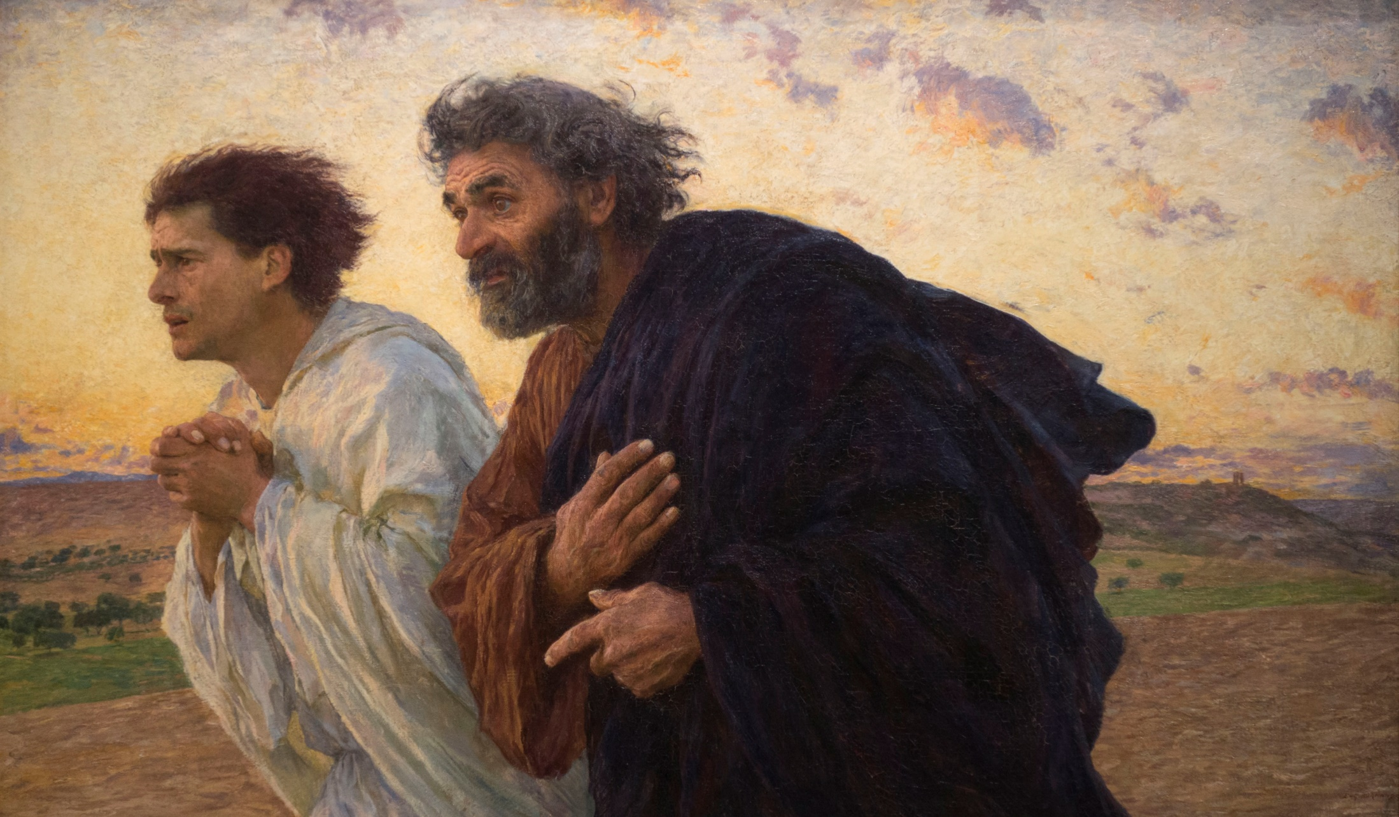

Slide 13
【马太福音 Matthew 16:15-17】
15 耶稣说：“你们说我是谁？”
He said to them, “But who do you say that I am?”
16 西门彼得回答说：“你是基督，是永生 神的儿子。” Simon Peter answered and said, “You are the Christ, the Son of the living God.”
17 耶稣对他说：“西门巴约拿，你是有福的！因为这不是属血肉的指示你的，乃是我在天上的父指示的。Jesus answered and said to him, “Blessed are you, Simon Bar-Jonah, for flesh and blood has not revealed this to you, but My Father who is in heaven.

Slide 14
【马太福音 Matthew 26:33-35】
33 彼得说：“众人虽然为你的缘故跌倒，我却永不跌倒。” Peter answered and said to Him, “Even if all are made to stumble because of You, I will never be made to stumble.”
34 耶稣说：“我实在告诉你：今夜鸡叫以先，你要三次不认我。” Jesus said to him, “Assuredly, I say to you that this night, before the rooster crows, you will deny Me three times.”
35 彼得说：“我就是必须和你同死，也总不能不认你。”众门徒都是这样说。Peter said to Him, “Even if I have to die with You, I will not deny You!” And so said all the disciples.

Slide 15
【马太福音 Matthew 26:74-75】
74 彼得就发咒起誓地说：“我不认得那个人。”立时，鸡就叫了。
Then he began to curse and swear, saying, “I do not know the Man!” Immediately a rooster crowed.
75 彼得想起耶稣所说的话：“鸡叫以先，你要三次不认我。”他就出去痛哭。
And Peter remembered the word of Jesus who had said to him, “Before the rooster crows, you will deny Me three times.” So he went out and wept bitterly.

Slide 17
【约翰福音 John 20:4-8】
4 两个人同跑，那门徒比彼得跑得更快，先到了坟墓，So they both ran together, and the other disciple outran Peter and came to the tomb first.
5 低头往里看，就见细麻布还放在那里，只是没有进去。And he, stooping down and looking in, saw the linen cloths lying there; yet he did not go in.
6 西门彼得随后也到了，进坟墓里去，就看见细麻布还放在那里；
Then Simon Peter came, following him, and went into the tomb; and he saw the linen cloths lying there,

Slide 18
【约翰福音 John 20:4-8】
7 又看见耶稣的裹头巾没有和细麻布放在一处，是另在一处卷着。
and the handkerchief that had been around His head, not lying with the linen cloths, but folded together in a place by itself.
8 先到坟墓的那门徒也进去，看见就信了。
Then the other disciple, who came to the tomb first, went in also; and he saw and believed.

Slide 19
【约翰福音 John 20:8-9】
8 先到坟墓的那门徒也进去，看见就信了。
Then the other disciple, who came to the tomb first, went in also; and he saw and believed.
9 因为他们还不明白圣经的意思，就是耶稣必要从死里复活。
For as yet they did not know the Scripture, that He must rise again from the dead.

Slide 20
【罗马书 Romans 1:4】
按圣善的灵说，因从死里复活，以大能显明是 神的儿子。
and declared to be the Son of God with power according to the Spirit of holiness, by the resurrection from the dead.

Slide 21
【哥林多前书 1 Corinthians 15:20-23】
20 但基督已经从死里复活，成为睡了之人初熟的果子。But now Christ is risen from the dead, and has become the firstfruits of those who have fallen asleep.
21 死既是因一人而来，死人复活也是因一人而来。
For since by man came death, by Man also came the resurrection of the dead.
22 在亚当里众人都死了，照样，在基督里众人也都要复活。For as in Adam all die, even so in Christ all shall be made alive.

Slide 22
【哥林多前书 1 Corinthians 15:20-23】
23 但各人是按着自己的次序复活，初熟的果子是基督，以后在祂来的时候，是那些属基督的。
But each one in his own order: Christ the firstfruits, afterward those who are Christ’s at His coming.

Slide 23
【约翰福音 John 19:42】
只因是犹太人的预备日，又因那坟墓近，他们就把耶稣安放在那里。
So there they laid Jesus, because of the Jews’ Preparation Day, for the tomb was nearby.

Slide 24
【约翰福音 John 11:25】
耶稣对她说：“复活在我，生命也在我；信我的人，虽然死了，也必复活。
Jesus said to her, “I am the resurrection and the life. He who believes in Me, though he may die, he shall live.

Slide 25
【哥林多前书 1 Corinthians 15:3-4】
3 我当日所领受又传给你们的，第一，就是基督照圣经所说，为我们的罪死了，
For I delivered to you first of all that which I also received: that Christ died for our sins according to the Scriptures,
4 而且埋葬了，又照圣经所说，第三天复活了，
and that He was buried, and that He rose again the third day according to the Scriptures,

Slide 26
【哥林多前书1 Corinthians 15:14，19-23】
14 若基督没有复活，我们所传的便是枉然，你们所信的也是枉然；
And if Christ is not risen, then our preaching is empty and your faith is also empty.
19 我们若靠基督，只在今生有指望，就算比众人更可怜。
If in this life only we have hope in Christ, we are of all men the most pitiable.

Slide 27
【哥林多前书1 Corinthians 15:14，19-23】
20 但基督已经从死里复活，成为睡了之人初熟的果子。
But now Christ is risen from the dead, and has become the firstfruits of those who have fallen asleep.
21 死既是因一人而来，死人复活也是因一人而来。
For since by man came death, by Man also came the resurrection of the dead.

Slide 28
【哥林多前书1 Corinthians 15:14，19-23】
22 在亚当里众人都死了；照样，在基督里众人也都要复活。
For as in Adam all die, even so in Christ all shall be made alive.
23 但各人是按着自己的次序复活:初熟的果子是基督；以后在祂来的时候，是那些属基督的。
But each one in his own order: Christ the firstfruits, afterward those who are Christ’s at His coming.

