Slide 1
【約翰一書 1 John 1:1-10】
1 論到從起初原有的生命之道，就是我們所聽見，所看見，親眼看過，親手摸過的。
That which was from the beginning, which we have heard, which we have seen with our eyes, which we have looked upon, and our hands have handled, concerning the Word of life—
2 （這生命已經顯現出來，我們也看見過，現在又作見證，將原與父同在，且顯現與我們那永遠的生命傳給你們。）
the life was manifested, and we have seen, and bear witness, and declare to you that eternal life which was with the Father and was manifested to us—

Slide 2
【約翰一書 1 John 1:1-10】
3 我們將所看見、所聽見的傳給你們，使你們與我們相交。我們乃是與父幷祂兒子耶穌基督相交的。
that which we have seen and heard we declare to you, that you also may have fellowship with us; and truly our fellowship is with the Father and with His Son Jesus Christ.
4 我們將這些話寫給你們，使你們（有古卷作“我們”）的喜樂充足。
And these things we write to you that your joy may be full.

Slide 3
【約翰一書 1 John 1:1-10】
5 神就是光，在祂毫無黑暗。這是我們從主所聽見，又報給你們的信息。
This is the message which we have heard from Him and declare to you, that God is light and in Him is no darkness at all.
6 我們若說是與 神相交，却仍在黑暗裏行，就是說謊話，不行真理了。
If we say that we have fellowship with Him, and walk in darkness, we lie and do not practice the truth.

Slide 4
【約翰一書 1 John 1:1-10】
7 我們若在光明中行，如同 神在光明中，就彼此相交，祂兒子耶穌的血也洗淨我們一切的罪。
But if we walk in the light as He is in the light, we have fellowship with one another, and the blood of Jesus Christ His Son cleanses us from all sin.
8 我們若說自己無罪，便是自欺，真理不在我們心裏了；
If we say that we have no sin, we deceive ourselves, and the truth is not in us.

Slide 5
【約翰一書 1 John 1:1-10】
9 我們若認自己的罪， 神是信實的，是公義的，必要赦免我們的罪，洗淨我們一切的不義；
If we confess our sins, He is faithful and just to forgive us our sins and to cleanse us from all unrighteousness.
10 我們若說自己沒有犯過罪，便是以 神爲說謊的，祂的道也不在我們心裏了。
If we say that we have not sinned, we make Him a liar, and His word is not in us.

Slide 6
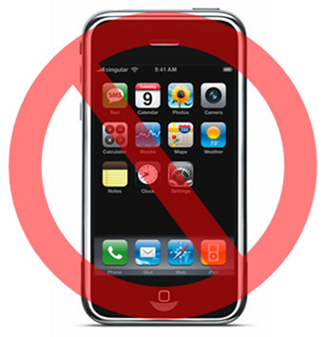
Prepare our hearts for the worship Thank you for silencing the phone

Slide 7
你坐着为王 You Sit on the Throne (1/5)
主耶和华 满有怜悯和恩典 我投靠在祢翅膀荫下 当我回转 一宿虽然有哭泣 早晨必欢呼喜乐
Lord, you have abundant mercy and grace In you, I take refuge When I return, weeping may remain for a night but rejoicing comes in the morning

Slide 8
你坐着为王 You Sit on the Throne (2/5)
祢坐着为王 到永永远远 虽洪水翻腾 我坚定仰望祢 祢坐着为王 垂听我呼求 使我灵苏醒 有复活的生命
You sit as King forever and ever
Although floods rise and fall I look up to You
You sit as King, hearing my cry Awake my soul let me have resurrected life

Slide 9
你坐着为王 You Sit on the Throne (3/5)
主耶和华 满有怜悯和恩典 我投靠在祢翅膀荫下 当我回转 一宿虽然有哭泣 早晨必欢呼喜乐
Lord, you have abundant mercy and grace In you, I take refuge When I return, weeping may remain for a night but rejoicing comes in the morning

Slide 10
你坐着为王 You Sit on the Throne (4/5)
祢坐着为王 到永永远远 虽洪水翻腾 我坚定仰望祢 祢坐着为王 垂听我呼求 使我灵苏醒 有复活的生命
You sit as King forever and ever
Although floods rise and fall I look up to You
You sit as King, hearing my cry Awake my soul let me have resurrected life

Slide 11
你坐着为王 You Sit on the Throne (5/5)
祢坐着为王 到永永远远 虽洪水翻腾 我坚定仰望祢 祢坐着为王 垂听我呼求 使我灵苏醒 有复活的生命
You sit as King forever and ever
Although floods rise and fall I look up to You
You sit as King, hearing my cry Awake my soul let me have resurrected life

Slide 12
我心切切渴慕你 My Heart Shall Long for You (1/7)
我心切切渴慕你，
乾旱疲乏無水之地。
你是我一切，我心完全屬於你，
只願更多與你相親。
My heart shall long for You,
You are my sun, You are my shield.
You are my everything, all my love belongs to You.
I want to be closer to You.

Slide 13
我心切切渴慕你 My Heart Shall Long for You (2/7)
我要切切尋求你，
乾旱疲乏無水之地。
你是我一切，我心不住思念你，
只願與你面對面。
My heart shall seek after You.
You are my sun, You are my shield.
You're my everything, all my heart belongs to You.
I long to be face to face.

Slide 14
我心切切渴慕你 My Heart Shall Long for You (3/7)
我要永永遠遠來愛你，
我要永永遠遠渴慕你。
你是我一切，我心不住思念你，
只願與你面對面
Forever I'll love You with my life.
Forever I'll wait for You, my Lord.
You're my everything, all my heart belongs to You.
I long to be face to face.

Slide 15
我心切切渴慕你 My Heart Shall Long for You (4/7)
我要切切尋求你，
乾旱疲乏無水之地。
你是我一切，我心不住思念你，
只願與你面對面。
My heart shall seek after You.
You are my sun, You are my shield.
You're my everything, all my heart belongs to You.
I long to be face to face.

Slide 16
我心切切渴慕你 My Heart Shall Long for You (5/7)
我要永永遠遠來愛你，
我要永永遠遠渴慕你。
你是我一切，我心不住思念你，
只願與你面對面
Forever I'll love You with my life.
Forever I'll wait for You, my Lord.
You're my everything, all my heart belongs to You.
I long to be face to face.

Slide 17
我心切切渴慕你 My Heart Shall Long for You (6/7)
我要永永遠遠來愛你，
我要永永遠遠渴慕你。
你是我一切，我心不住思念你，
只願與你面對面
Forever I'll love You with my life.
Forever I'll wait for You, my Lord.
You're my everything, all my heart belongs to You.
I long to be face to face.

Slide 18
我心切切渴慕你 My Heart Shall Long for You (7/7)
你的愛最美，我心不住思念你，
只願與你面對面。
You are beautiful, all my heart belongs to You.
I long to be face to face.

Slide 19
Please stand up!

Slide 20
神羔羊配得 Worthy is the lamb
感謝祢的十字架
感謝祢付上代價
擔當我罪和羞愧 使我完全 賜下奇妙恩典 Thank you for the cross, Lord Thank you for the price You paid Bearing all my sin and shame In love You came And gave amazing grace

Slide 21
感謝祢無比大愛 感謝祢釘痕雙手 寶血洗淨我污穢 使我了解 祢完全包容赦免 Thank you for this love, Lord Thank you for the nail pierced hands Washed me in Your cleansing flow Now all I know Your forgiveness and embrace

Slide 22
神羔羊配得 坐在寶座上 頭帶著尊貴冠冕
祢做王到永遠 Worthy is the Lamb Seated on the throne Crown You now with many crowns You reign victorious

Slide 23
來尊崇讚美 耶穌神兒子 從天降下被釘十架 神羔羊配得 神羔羊配得 High and lifted up Jesus Son of God The Darling of Heaven crucified Worthy is the Lamb Worthy is the Lamb

Slide 24
神羔羊配得 Worthy is the lamb
感謝祢的十字架
感謝祢付上代價
擔當我罪和羞愧 使我完全 賜下奇妙恩典 Thank you for the cross, Lord Thank you for the price You paid Bearing all my sin and shame In love You came And gave amazing grace

Slide 25
感謝祢無比大愛 感謝祢釘痕雙手 寶血洗淨我污穢 使我了解 祢完全包容赦免 Thank you for this love, Lord Thank you for the nail pierced hands Washed me in Your cleansing flow Now all I know Your forgiveness and embrace

Slide 26
神羔羊配得 坐在寶座上 頭帶著尊貴冠冕
祢做王到永遠 Worthy is the Lamb Seated on the throne Crown You now with many crowns You reign victorious

Slide 27
來尊崇讚美 耶穌神兒子 從天降下被釘十架 神羔羊配得 神羔羊配得 High and lifted up Jesus Son of God The Darling of Heaven crucified Worthy is the Lamb Worthy is the Lamb

Slide 28
聖餐 Holy Communion
Boise Chinese Christian Church
11/07/2021

Slide 29
【林前 1 Corinthians 11:23-29】
23 我當日傳給你們的，原是從主領受的，就是主耶穌被賣的那一夜，拿起餅來，
For I received from the Lord that which I also delivered to you: that the Lord Jesus on the same night in which He was betrayed took bread;
24 祝謝了，就掰開，說:“這是我的身體，爲你們舍的(“舍”有古卷作“掰開”)，你們應當如此行，爲的是記念我。”
and when He had given thanks, He broke it and said, “Take, eat; this is My body which is broken for you; do this in remembrance of Me.”

Slide 30
【林前 1 Corinthians 11:23-29】
25 飯後，也照樣拿起杯來，說：“這杯是用我的血所立的新約。你們每逢喝的時候，要如此行，爲的是記念我。”
In the same manner He also took the cup after supper, saying, “This cup is the new covenant in My blood. This do, as often as you drink it, in remembrance of Me.”
26 你們每逢吃這餅，喝這杯，是表明主的死，直等到祂來。For as often as you eat this bread and drink this cup, you proclaim the Lord’s death till He comes.

Slide 31
【林前 1 Corinthians 11:23-29】
27 所以，無論何人不按理吃主的餅、喝主的杯，就是干犯主的身、主的血了。
Therefore whoever eats this bread or drinks this cup of the Lord in an unworthy manner will be guilty of the body and blood of the Lord.
28 人應當自己省察，然後吃這餅、喝這杯。
But let a man examine himself, and so let him eat of the bread and drink of the cup.

Slide 32
【林前 1 Corinthians 11:23-29】
29 因爲人吃喝，若不分辨是主的身體，就是吃喝自己的罪了。
For he who eats and drinks in an unworthy manner eats and drinks judgment to himself, not discerning the Lord’s body.

Slide 33
信息时间

Slide 34
道路、真理、生命（三） The Way, The Truth, The Life（3）
Boise Chinese Christian Church
11/07/2021

Slide 35
【約翰福音 John 14:6】
耶穌說：“我就是道路、真理、生命；若不藉著我，沒有人能到父那裏去。
Jesus said to him, “I am the way, the truth, and the life. No one comes to the Father except through Me.

Slide 36
【創世記 Genesis 1:27】
神就照著自己的形像造人，乃是照著祂的形像造男造女。
So God created man in His own image; in the image of God He created him; male and female He created them.

Slide 37
【創世記 Genesis 2:7】
耶和華 神用地上的塵土造人，將生氣吹在他鼻孔裏，他就成了有靈的活人，名叫亞當。
And the Lord God formed man of the dust of the ground, and breathed into his nostrils the breath of life; and man became a living being.

Slide 38
【羅馬書 Romans 3:23】
因爲世人都犯了罪，虧缺了神的榮耀，
for all have sinned and fall short of the glory of God,
【雅各書 James 1:15】
私欲既懷了胎，就生出罪來；罪既長成，就生出死來。
Then, when desire has conceived, it gives birth to sin; and sin, when it is full-grown, brings forth death.

Slide 39
【哥林多前書 1 Corinthians 15:22a】
在亞當裏衆人都死了……For as in Adam all die….
【以弗所書 Ephesians 2:1a】
你們死在過犯罪惡之中……
And you …. were dead in trespasses and sins,

Slide 40
【約翰福音 John 14:6】
耶穌說：“我就是道路、真理、生命；若不藉著我，沒有人能到父那裏去。
Jesus said to him, “I am the way, the truth, and the life. No one comes to the Father except through Me.
【約翰福音 John 1:4】
生命在祂裏頭，這生命就是人的光。
In Him was life, and the life was the light of men.

Slide 41
【約翰福音 John 10:10】
盜賊來，無非要偷竊、殺害、毀壞；我來了，是要叫羊（或作“人”）得生命，幷且得的更豐盛。
The thief does not come except to steal, and to kill, and to destroy. I have come that they may have life, and that they may have it more abundantly.

Slide 42
【約翰福音 John 6:66-68】
66 從此，祂門徒中多有退去的，不再和祂同行。
From that time many of His disciples went back and walked with Him no more.
67 耶穌就對那十二個門徒說：“你們也要去嗎？”
Then Jesus said to the twelve, “Do you also want to go away?”
68 西門彼得回答說：“主啊，你有永生之道，我們還歸從誰呢？
But Simon Peter answered Him, “Lord, to whom shall we go? You have the words of eternal life.

Slide 43
【約翰福音 John 11:25-26】
25 耶穌對她說：“復活在我，生命也在我；信我的人，雖然死了，也必復活。
Jesus said to her, “I am the resurrection and the life. He who believes in Me, though he may die, he shall live.
26 凡活著信我的人必永遠不死。你信這話嗎？”
And whoever lives and believes in Me shall never die. Do you believe this?”

Slide 44
【希伯來書 Hebrews 11:16】
他們却羡慕一個更美的家鄉，就是在天上的。所以 神被稱爲他們的 神，幷不以爲耻，因爲祂已經給他們預備了一座城。
But now they desire a better, that is, a heavenly country. Therefore God is not ashamed to be called their God, for He has prepared a city for them.

Slide 45
【詩篇 Psalms 1:1-3】
1 不從惡人的計謀，不站罪人的道路，不坐褻慢人的座位，
Blessed is the man Who walks not in the counsel of the ungodly, Nor stands in the path of sinners, Nor sits in the seat of the scornful;
2 惟喜愛耶和華的律法，晝夜思想，這人便爲有福。
But his delight is in the law of the Lord, And in His law he meditates day and night.

Slide 46
【詩篇 Psalms 1:1-3】
3 他要像一棵樹栽在溪水旁，按時候結果子，葉子也不枯乾。凡他所作的盡都順利。
He shall be like a tree Planted by the rivers of water, That brings forth its fruit in its season, Whose leaf also shall not wither; And whatever he does shall prosper.

Slide 47
【耶利米書 Jeremiah 17:7-8】
7 倚靠耶和華、以耶和華爲可靠的，那人有福了。
“Blessed is the man who trusts in the Lord, And whose hope is the Lord.
8 他必像樹栽于水旁，在河邊扎根，炎熱來到，幷不懼怕，葉子仍必青翠，在乾旱之年毫無挂慮，而且結果不止。
For he shall be like a tree planted by the waters, Which spreads out its roots by the river, And will not fear when heat comes; But its leaf will be green, And will not be anxious in the year of drought, Nor will cease from yielding fruit.

Slide 48
【馬可福音 Mark 5:19-20】
19 耶穌不許，却對他說：“你回家去，到你的親屬那裏，將主爲你所作的是何等大的事，是怎樣憐憫你，都告訴他們。”
However, Jesus did not permit him, but said to him, “Go home to your friends, and tell them what great things the Lord has done for you, and how He has had compassion on you.”
20 那人就走了，在低加波利傳揚耶穌爲他作了何等大的事，衆人就都希奇。
And he departed and began to proclaim in Decapolis all that Jesus had done for him; and all marveled.

Slide 49
【路加福音 Luke 12:15】
于是對衆人說：“你們要謹慎自守，免去一切的貪心；因爲人的生命不在乎家道豐富。”
And He said to them, “Take heed and beware of covetousness, for one’s life does not consist in the abundance of the things he possesses.”

Slide 50
【馬可福音 Mark 8:35-37】
35 因爲凡要救自己生命的（“生命”或作“靈魂”。下同），必喪掉生命；凡爲我和福音喪掉生命的，必救了生命。For whoever desires to save his life will lose it, but whoever loses his life for My sake and the gospel’s will save it.
36 人就是賺得全世界，賠上自己的生命，有什麽益處呢？For what will it profit a man if he gains the whole world, and loses his own soul?
37 人還能拿什麽換生命呢？
Or what will a man give in exchange for his soul?

Slide 51
【約翰福音 John 5:12】
人有了 神的兒子就有生命，沒有 神的兒子就沒有生命。
He who has the Son has life; he who does not have the Son of God does not have life.
【詩篇 Psalms 36:9】
因爲在你那裏有生命的源頭，在你的光中，我們必得見光。
For with You is the fountain of life; In Your light we see light.

Slide 52
神羔羊配得 Worthy is the lamb
感謝祢的十字架
感謝祢付上代價
擔當我罪和羞愧 使我完全 賜下奇妙恩典 Thank you for the cross, Lord Thank you for the price You paid Bearing all my sin and shame In love You came And gave amazing grace

Slide 53
感謝祢無比大愛 感謝祢釘痕雙手 寶血洗淨我污穢 使我了解 祢完全包容赦免 Thank you for this love, Lord Thank you for the nail pierced hands Washed me in Your cleansing flow Now all I know Your forgiveness and embrace

Slide 54
神羔羊配得 坐在寶座上 頭帶著尊貴冠冕
祢做王到永遠 Worthy is the Lamb Seated on the throne Crown You now with many crowns You reign victorious

Slide 55
來尊崇讚美 耶穌神兒子 從天降下被釘十架 神羔羊配得 神羔羊配得 High and lifted up Jesus Son of God The Darling of Heaven crucified Worthy is the Lamb Worthy is the Lamb

Slide 56
报告事项
Announcement

Slide 57
请参加聚会的弟兄姊妹配戴口罩。如果没有口罩，教会会提供。每一次聚会后，教会都会做内部清洁消毒。
Please wear mask when join the worship, and church will provide mask if you don’t have one. Church will be cleaned and sanitized after every meeting.

Slide 58
鼓励大家参加教会活动：周二晚7点祷告会，周三早上10点Zoom姊妹会，周五晚7:30查经: 申命記; 成人主日學: 約翰一書。 We encourage everyone to participate our church’s activities: Tue 7pm prayer meeting, Wed 10am sisters fellowship via Zoom, Fri 7:30pm bible study (Deuteronomy), and the Adult Sunday School is studying the book of 1 John.

Slide 59
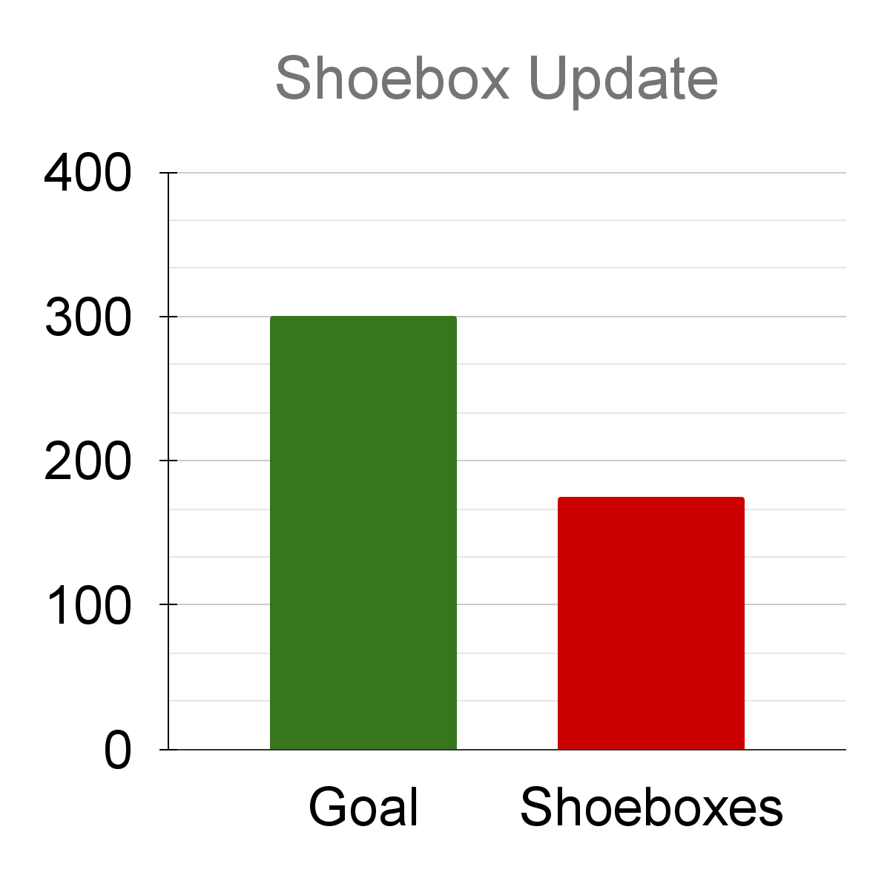
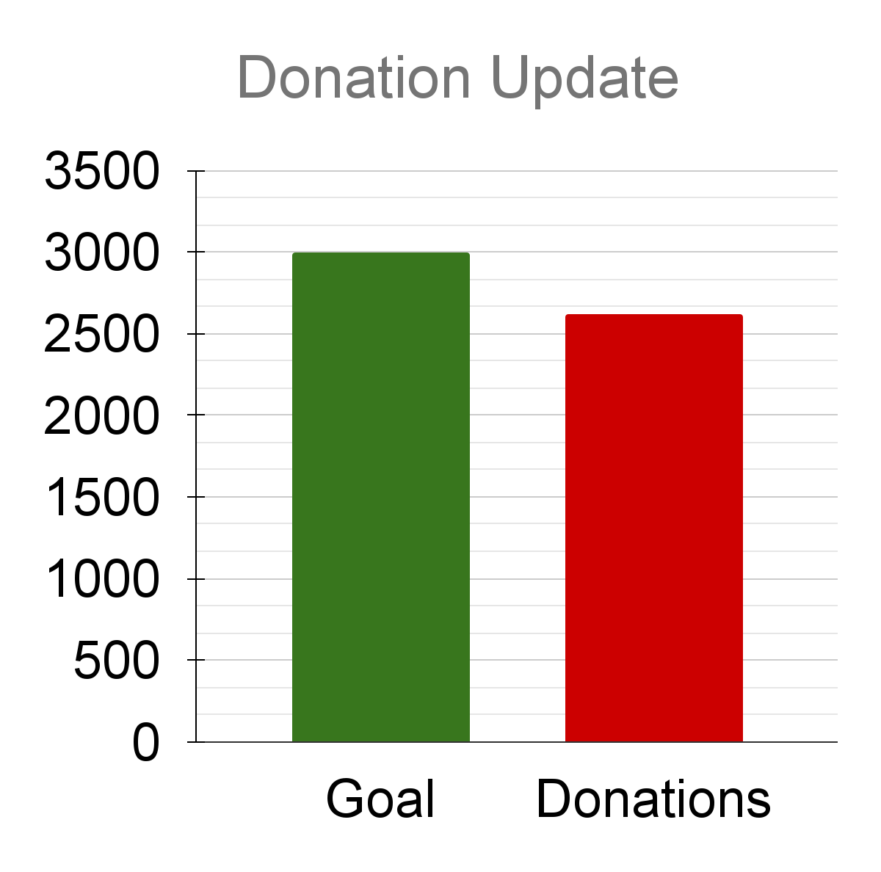
Shoebox 3.0 Update (11/7 --> 11/21)
$3000
300
$2620
175
He said to them, “Go into all the world and preach the gospel to all creation.” Mark 16: 15

Slide 60
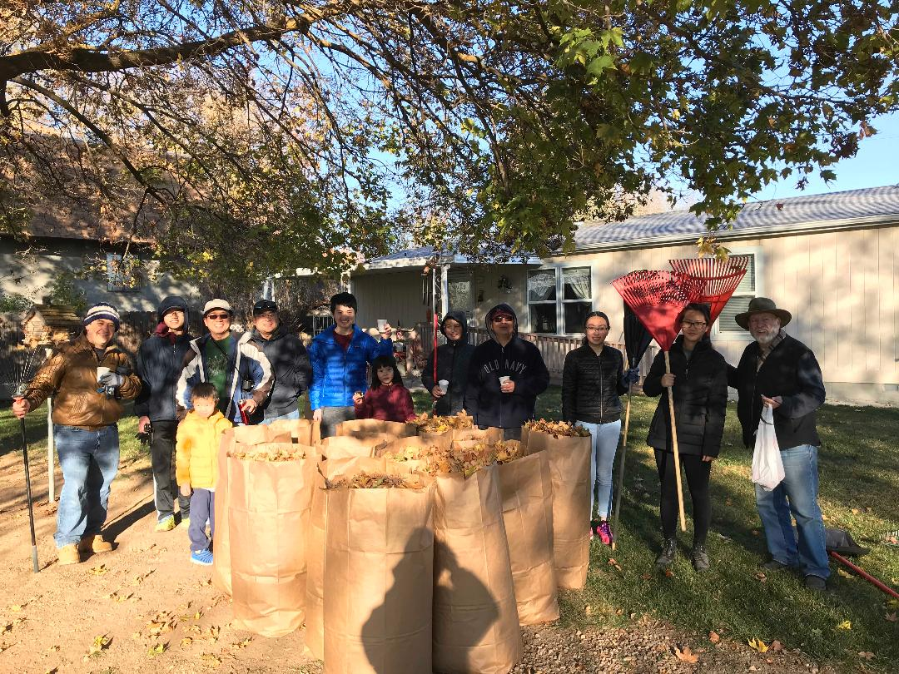
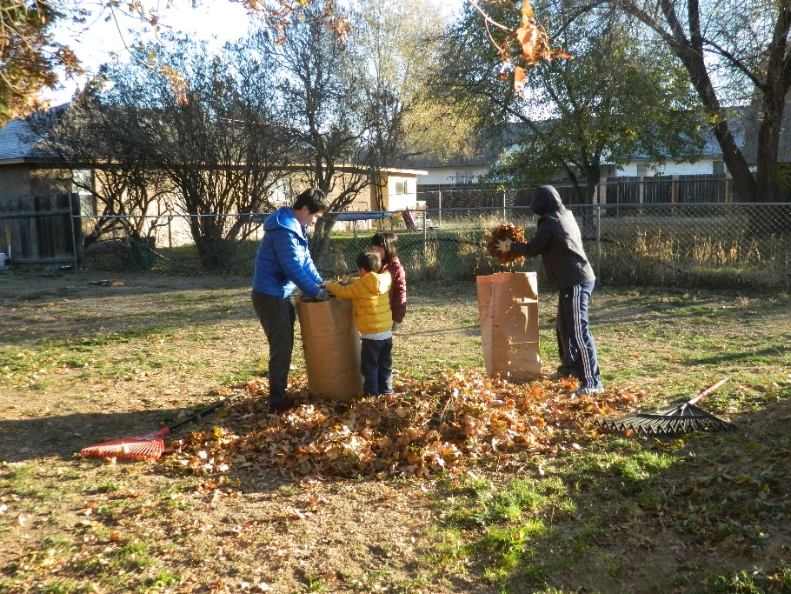
Rake Up Boise 是在 11/13 8am。 Please reserve your time for Rake Up Boise at 8am on Saturday, 11/13.

Slide 61
National Shoebox Collection Week
(11/15 – 11/22)
我們教會繼續是Boise地區shoebox收集站之一，今年全部採取curbside收集。如果要幫忙的，請跟福山弟兄(fwushan@yahoo.com)聯係。
BCCC continues to serve as one of the shoebox drop-off locations in the Boise area. We will only provide curbside collection this year. If you would like to help with the shoebox collection, please contact brother Fwu-Shan (fwushan@yahoo.com).

Slide 62
11/26週五晚上7:30 有感恩節聚會以Zoom綫上方式進行 。當天會有詩歌，弟兄姊妹的感恩分享以及馮濤弟兄的信息分享。請弟兄姊妹把時間空下來。
Thanksgiving Zoom gathering will be at 7:30pm on Friday, 11/26. There will be songs, sharing by our brothers and sisters, and Barnabas’s message sharing. Please reserve the time for this event.

Slide 63
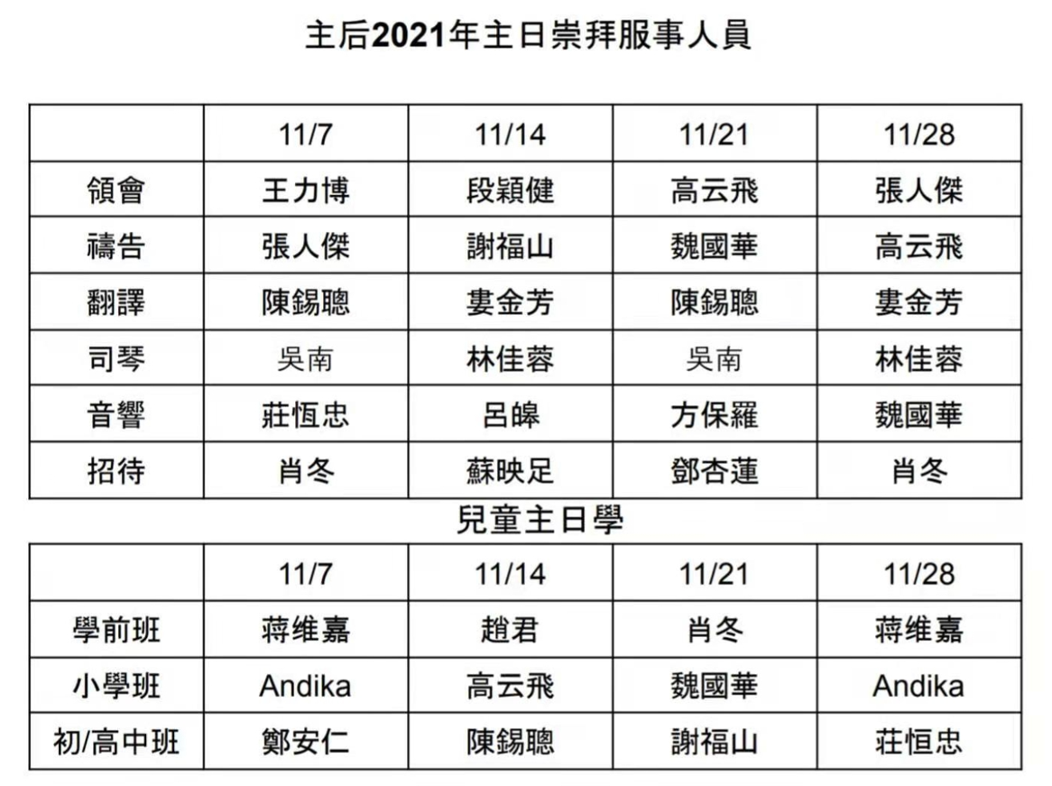

Slide 64
如果有任何奉献，请用支票寄到教会邮箱。
If you have offering, please send the check to church’s mail.
Boise Chinese Christian Church
1422 N Eldorado St.
Boise, ID 83704

Slide 65
10/31 奉献 offering：
General $1627
Shoebox $800

Slide 66
信仰告白
Apostle’s Creed
Boise Chinese Christian Church

Slide 67
使徒信經 Apostles' Creed
我信上帝，全能的父，創造天地的主。 我信我主耶穌基督，上帝的獨生子； 因著聖靈感孕，從童貞女馬利亞所生； 在本丟彼拉多手下受難，被釘在十字架上，受死，埋葬； | I believe in God the Father, Almighty, Maker of heaven and earth: And in Jesus Christ, his only begotten Son, our Lord: Who was conceived by the Holy Ghost, born of the Virgin Mary: Suffered under Pontius Pilate; was crucified, dead and buried: He descended into hell:

Slide 68
使徒信經 Apostles' Creed
降在陰間；第三天從死裏復活； 後升天，坐在全能父上帝的右邊； 將來必從那裏降臨，審判活人，死人。 我信聖靈； | The third day he rose again from the dead: He ascended into heaven, and sits at the right hand of God the Father Almighty: From thence he shall come to judge the quick and the dead: I believe in the Holy Ghost:

Slide 69
使徒信經 Apostles' Creed
我信聖而公之教會； 我信聖徒相通； 我信罪得赦免， 我信身體復活； 我信永生。阿們！ | I believe in the holy universal church: the communion of saints: The forgiveness of sins: The resurrection of the body: And the life everlasting. Amen.

Slide 70
祝禱 Benediction
【哥林多後書13:14】 願 主耶穌基督的恩惠、 神的慈愛、 聖靈的感動， 常與你們衆人同在！ | 【2 Corinthians 13:14】 The grace of the Lord Jesus Christ, and the love of God, and the communion of the Holy Spirit be with you all. Amen.

