Slide 1
【馬太福音 Matthew 5：44】
只是我告訴你們，要愛你們的仇敵，為那逼迫你們的禱告。
But I say to you, love your enemies, bless those who curse you, do good to those who hate you, and pray for those who spitefully use you and persecute you,

Slide 2
【馬太福音 Matthew 5: 38-48】
38“你們聽見有話說：‘以眼還眼，以牙還牙。’
"You have heard that it was said, "An eye for an eye and a tooth for a tooth.‘
39只是我告訴你們：不要與惡人作對。有人打你的右臉，連左臉也轉過來由他打；
But I tell you not to resist an evil person. But whoever slaps you on your right cheek, turn the other to him also.

Slide 3
40有人想要告你，要拿你的裡衣，連外衣也由他拿去；
If anyone wants to sue you and take away your tunic, let him have your cloak also.
41有人強逼你走一裡路，你就同他走二裡；
And whoever compels you to go one mile, go with him two.
42有求你的，就給他；有向你借貸的，不可推辭。”
Give to him who asks you, and from him who wants to borrow from you do not turn away.Love Your Enemies

Slide 4
43“你們聽見有話說：‘當愛你的鄰舍，恨你的仇敵。’
"You have heard that it was said, "You shall love your neighbor and hate your enemy.‘
44只是我告訴你們，要愛你們的仇敵，為那逼迫你們的禱告。
But I say to you, love your enemies, bless those who curse you, do good to those who hate you, and pray for those who spitefully use you and persecute you,

Slide 5
45這樣，就可以作你們天父的兒子。因為他叫日頭照好人，也照歹人；降雨給義人，也給不義的人。
that you may be sons of your Father in heaven; for He makes His sun rise on the evil and on the good, and sends rain on the just and on the unjust.
46你們若單愛那愛你們的人，有什麼賞賜呢？就是稅吏不也是這樣行嗎？
For if you love those who love you, what reward have you? Do not even the tax collectors do the same?

Slide 6
47你們若單請你弟兄的安，比人有什麼長處呢？就是外邦人不也是這樣行嗎？
And if you greet your brethren only, what do you do more than others? Do not even the tax collectors do so?
48所以，你們要完全，像你們的天父完全一樣。”
Therefore you shall be perfect, just as your Father in heaven is perfect.

Slide 7
【馬太福音Matthew 5：17-19】
17“莫想我來要廢掉律法和先知；我來不是要廢掉，乃是要成全。"Do not think that I came to destroy the Law or the Prophets. I did not come to destroy but to fulfill.
18我實在告訴你們，就是到天地都廢去了，律法的一點一畫也不能廢去，都要成全。For assuredly, I say to you, till heaven and earth pass away, one jot or one tittle will by no means pass from the law till all is fulfilled.

Slide 8
19所以，無論何人廢掉這誡命中最小的一條，又教訓人這樣作，他在天國要稱為最小的；但無論何人遵行這誡命，又教訓人遵行，他在天國要稱為大的。
Whoever therefore breaks one of the least of these commandments, and teaches men so, shall be called least in the kingdom of heaven; but whoever does and teaches them, he shall be called great in the kingdom of heaven.

Slide 9
【出埃及記 Exodus 21:22-25】
【利未記 Leviticus 24：13-22】
【申命記 19：15-21】

Slide 10
【創世記2:23】
那人說：“這是我骨中的骨，肉中的肉，可以稱她為女人，因為她是從男人身上取出來的。”
And Adam said:"This is now bone of my bones And flesh of my flesh; She shall be called Woman, Because she was taken out of Man."

Slide 11
【創世記4:23-24】
拉麥對他兩個妻子說：“亞大、洗拉，聽我的聲音；拉麥的妻子細聽我的話語：壯年人傷我，我把他殺了；少年人損我，我把他害了（或作“我殺壯士卻傷自己；我害幼童卻損本身”）。若殺該隱，遭報七倍；殺拉麥，必遭報七十七倍。”
Then Lamech said to his wives:"Adah and Zillah, hear my voice; Wives of Lamech, listen to my speech! For I have killed a man for wounding me, Even a young man for hurting me. If Cain shall be avenged sevenfold, Then Lamech seventy-sevenfold."

Slide 12
【箴言24:29】不可說：“人怎樣待我，我也怎樣待他，我必照他所行的報復他。”
Do not say, "I will do to him just as he has done to me; I will render to the man according to his work.“
【箴言25:21-22】你的仇敵若餓了，就給他飯吃；若渴了，就給他水喝；因為你這樣行就是把炭火堆在他的頭上；耶和華也必賞賜你。
If your enemy is hungry, give him bread to eat; And if he is thirsty, give him water to drink; For so you will heap coals of fire on his head, And the LORD will reward you.

Slide 13
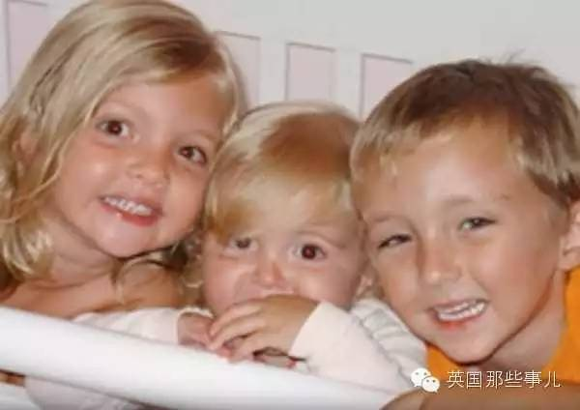
3个活波可爱的孩子，右边的男孩5岁，左边的女孩4岁，中间最小的才2岁

Slide 14
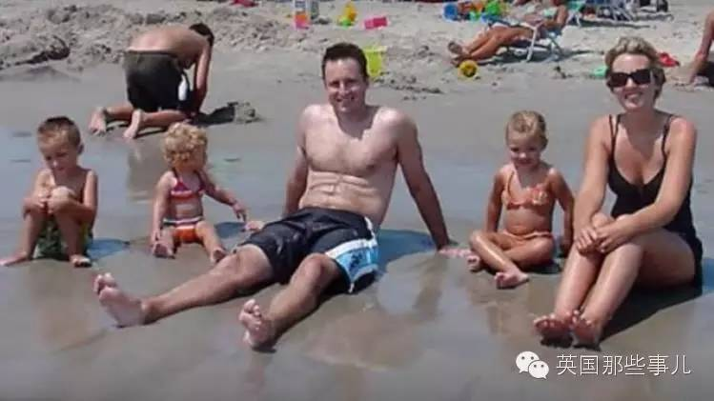
这是一个幸福快乐的5口之家

Slide 15
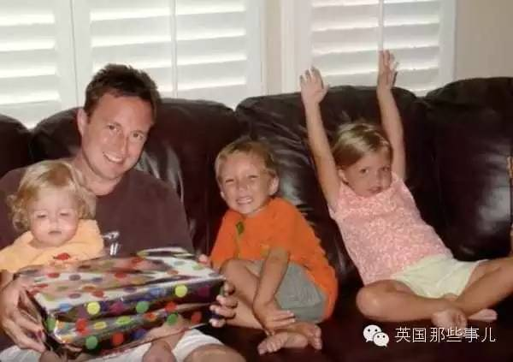
3个孩子都是那么可爱

Slide 16
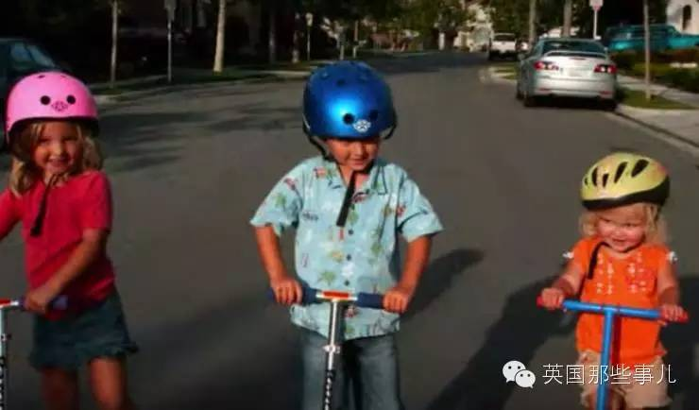
3个孩子都是那么可爱

Slide 17
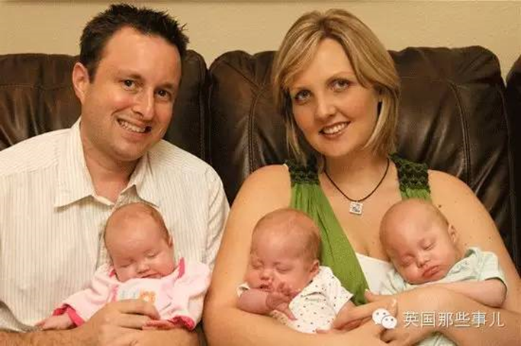
九年后……

Slide 18
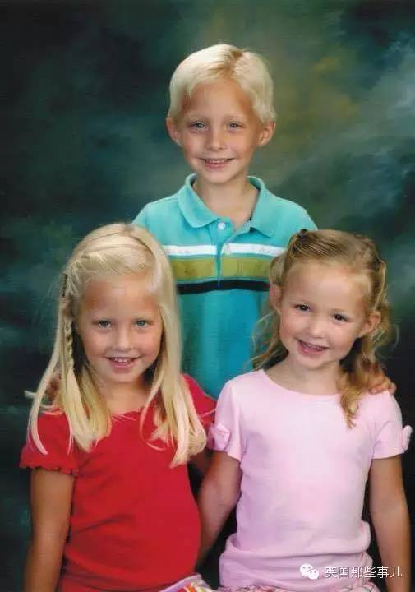
九年后……

Slide 19
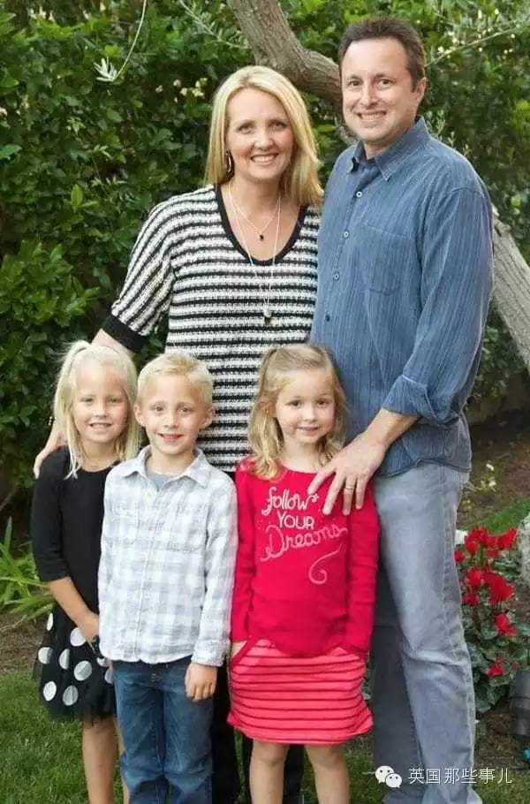
九年后……

Slide 20
【羅馬書12:19-21】
19親愛的弟兄，不要自己伸冤，寧可讓步，聽憑主怒（或作“讓人發怒”）。因為經上記著：“主說，伸冤在我，我必報應。”
Beloved, do not avenge yourselves, but rather give place to wrath; for it is written, "Vengeance is Mine, I will repay," says the Lord.

Slide 21
20所以，“你的仇敵若餓了，就給他吃；若渴了，就給他喝。因為你這樣行，就是把炭火堆在他的頭上。”
Therefore, "If your enemy is hungry, feed him; If he is thirsty, give him a drink; For in so doing you will heap coals of fire on his head."
21你不可為惡所勝，反要以善勝惡。
Do not be overcome by evil, but overcome evil with good.

